Slide 1
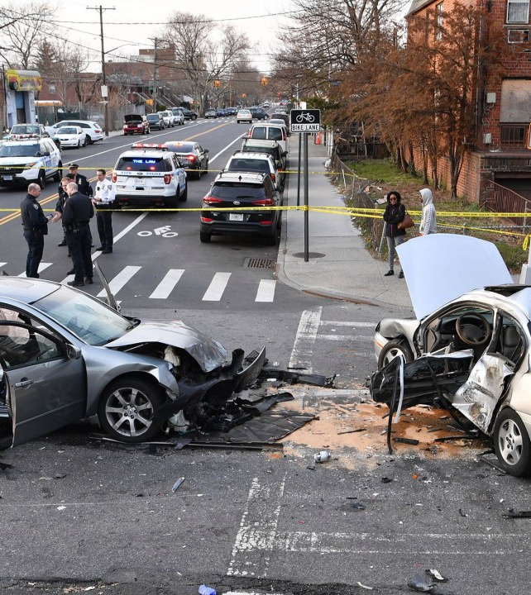
Analysis of New York City Motor Collision (2012 – 2022)
By: Aditya Agarwal
17th May 2022

Slide 2
UNDERSTANDING THE DATA
01
It is important to understand our data and our problem statement i.e., how to decrease the number of injuries and deaths in New York City.
PREPARING THE DATA
APPROACH FOR ANALYSIS
02
After understanding our dataset, it is essential to prepare the data. We have used GCP Big Query to remove null values and duplicate entries.
PERFORM ANALYSIS
03
We have carried out Time-series analysis and made dashboards to understand more about the factors and causes for Motor collisions in New York city.
04
GET INSIGHTS
We generated interactive tableau dashboards to support our findings and get insights from the data.
05
GIVE RECOMMENDATIONS
Based on our analysis, we will provide recommendations to decrease the number of Motor collisions.

Slide 3
SUMMARY
The NYPD began publishing a data set of every recorded vehicle collision in the city in July of 2012.
This project aims to analyze the Brooklyn Traffic Collision dataset and present visually identifiable patterns that would enable city planners, traffic management, and commuters to make informed choices and reduce the risk of collisions.
From 2012 to 2022, there were approximately 1,888,284 collisions and 5,088 deaths in New York City.
The majority of crashes happened between 4 Pm - 5 Pm, with 281 people killed and 75.539 people injured.

Slide 4
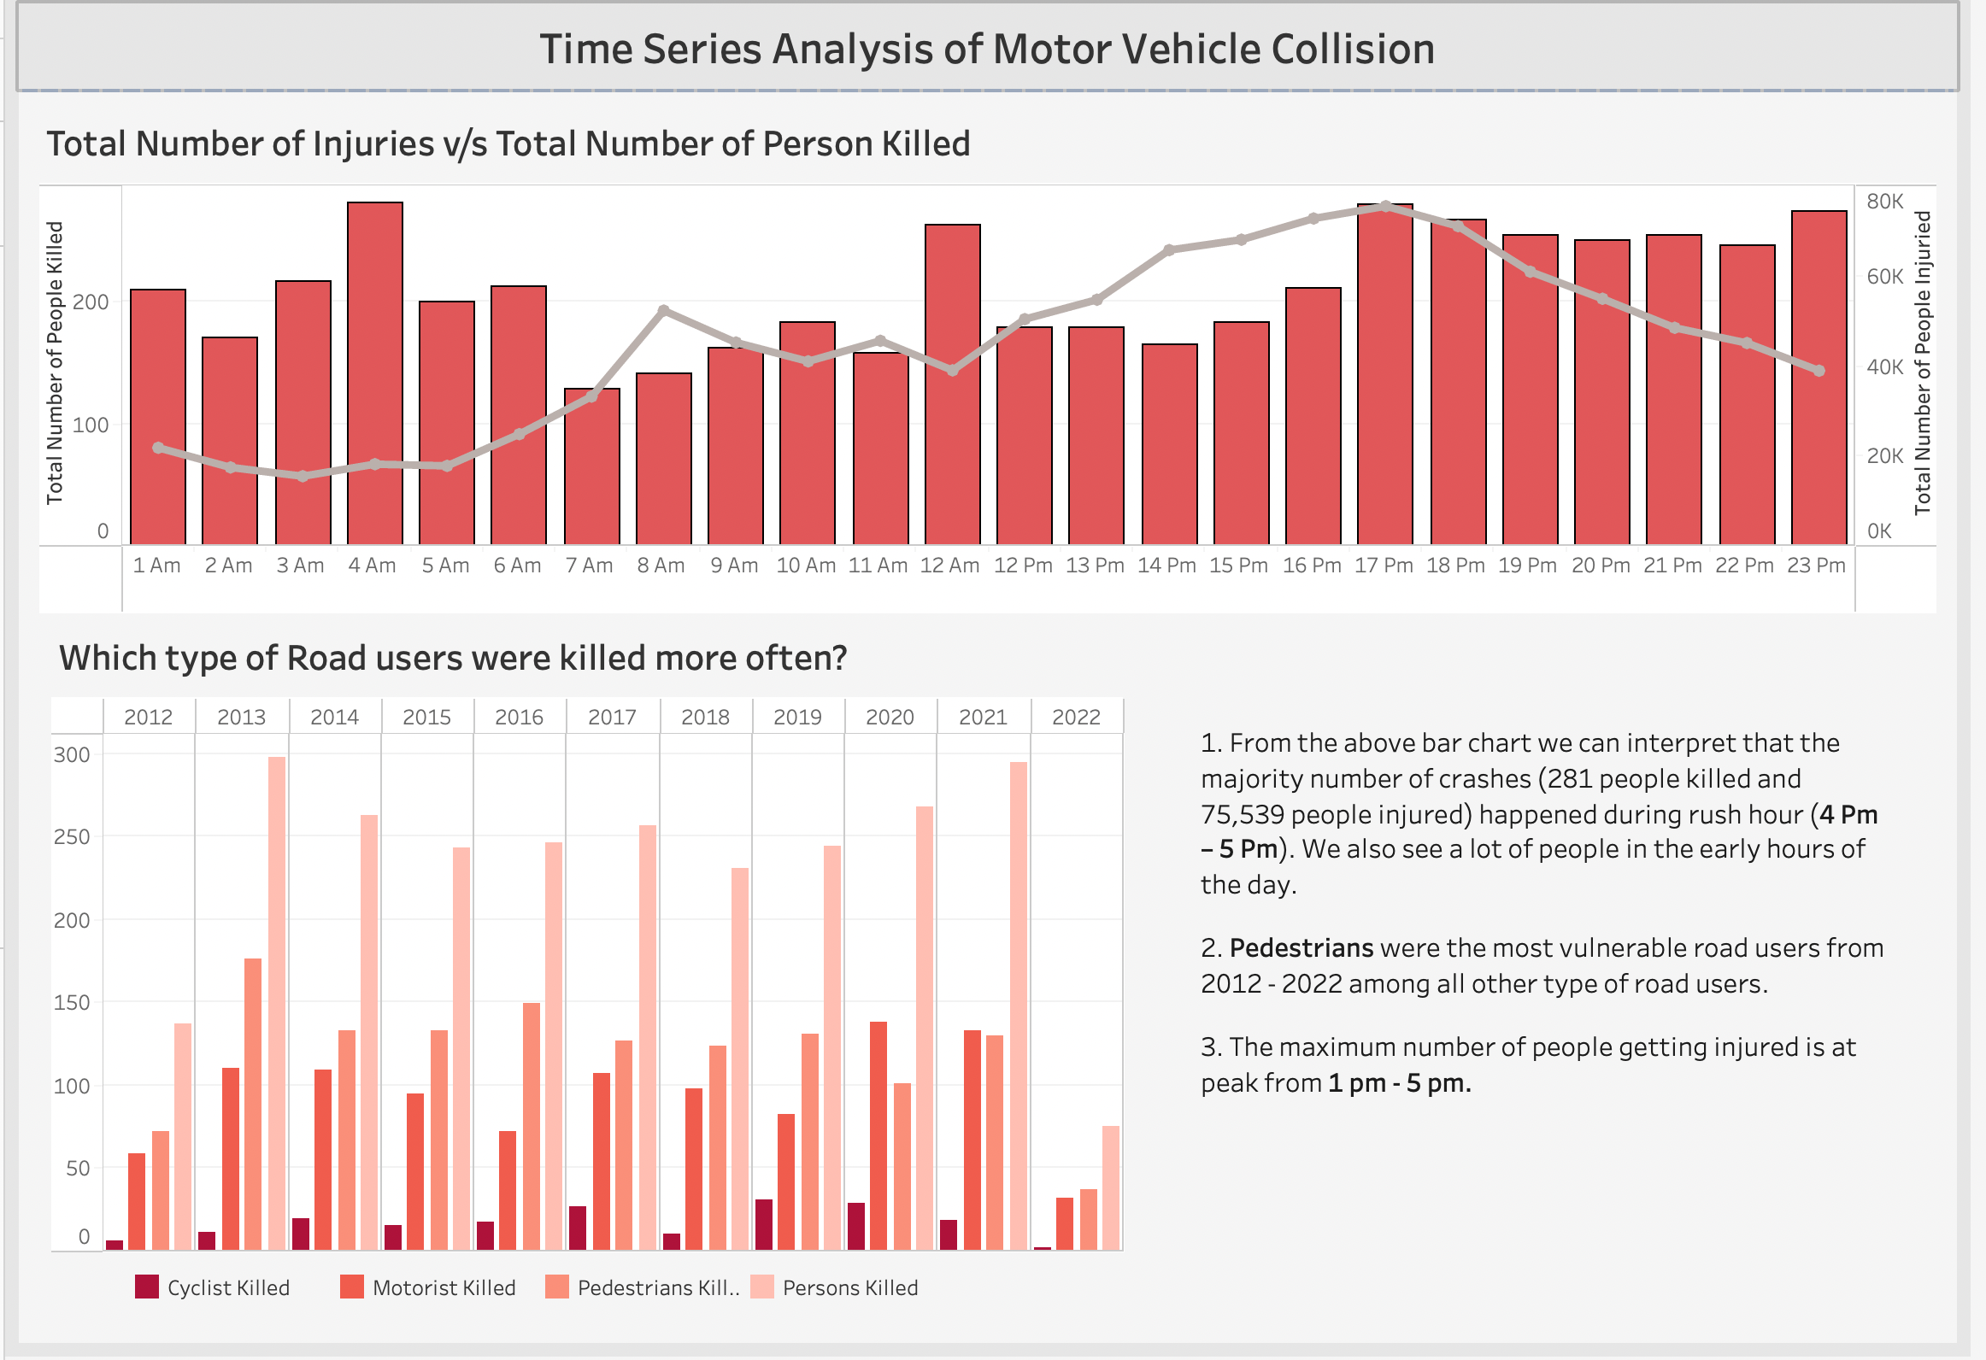

Slide 5
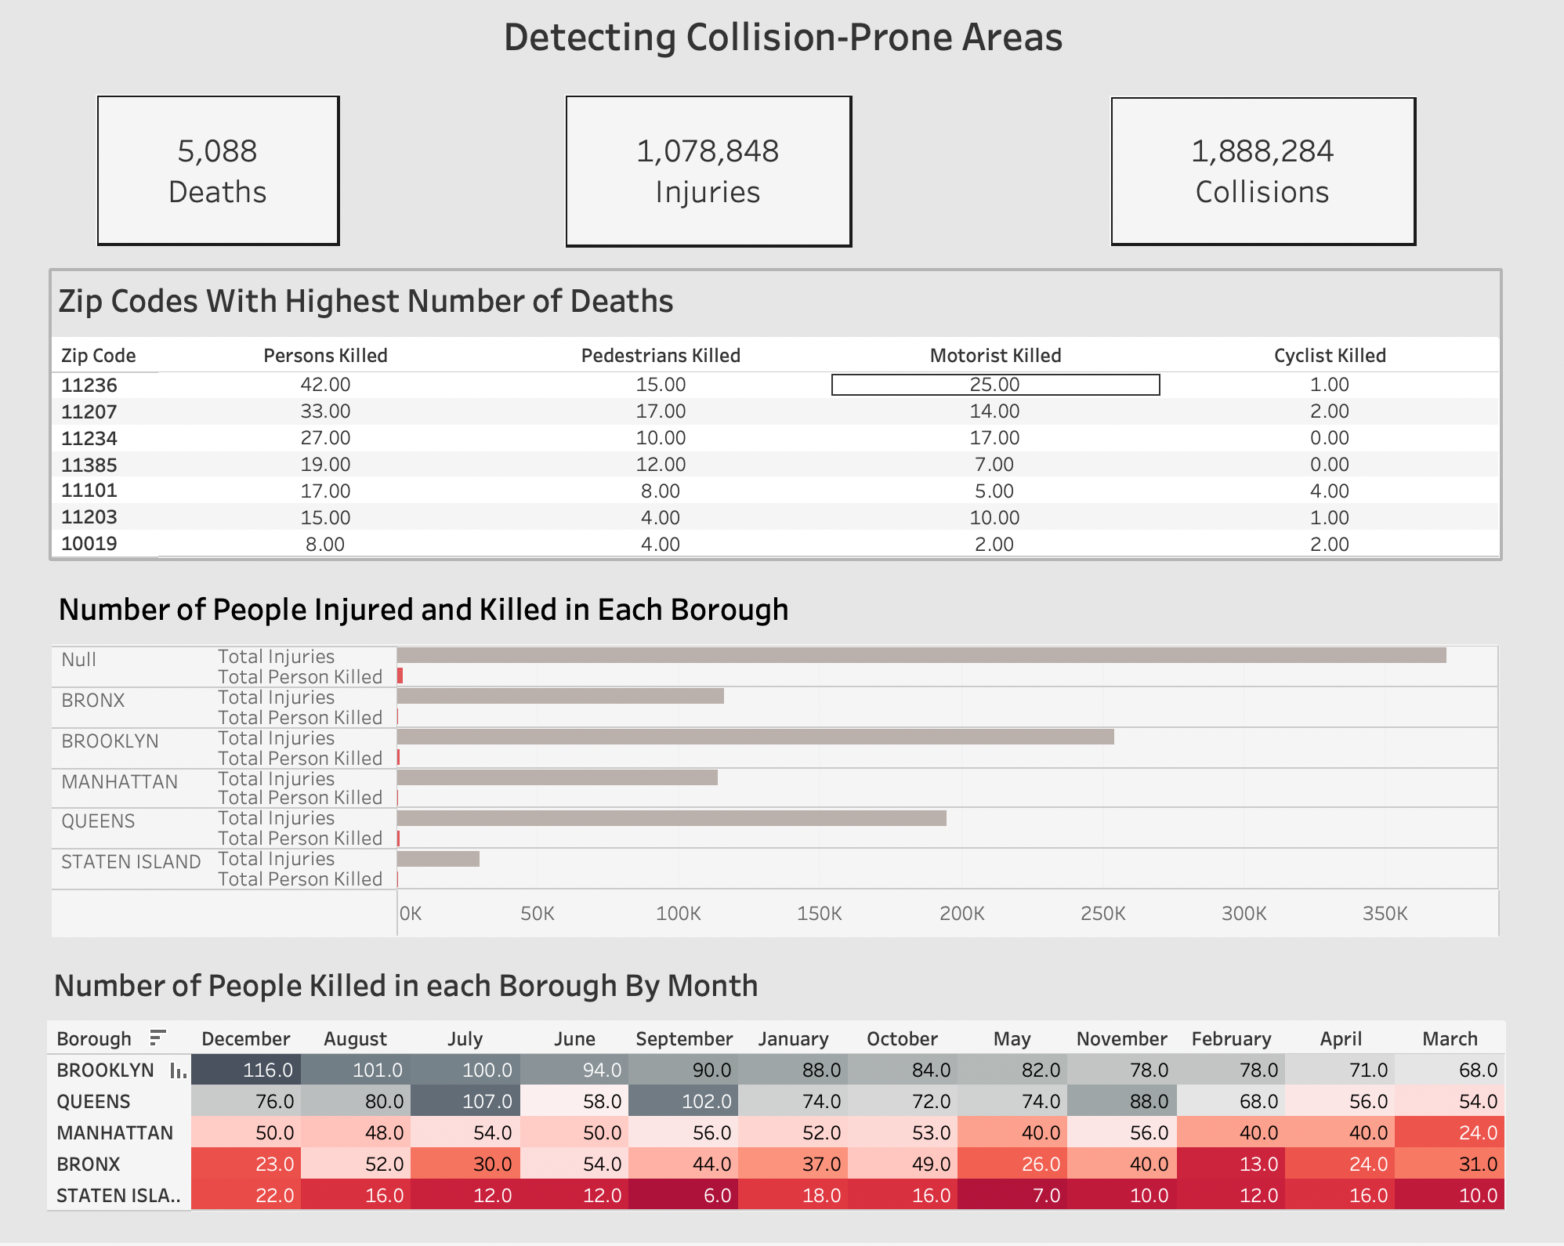

Slide 6
INSIGHTS
Between 4 pm to 5 pm was the peak time of the day when the maximum number of people got injured.
The number of people getting injured was rising from 2012 and was at its peak in 2018 with a value of 123,859 injuries.
In 2018, the total number of injured people decreased to 29,604 injuries in 2022.
The highest number of deaths and injuries were majorly caused by a lack of "Driver’s attention." The other factors also point toward the Driver’s lack of driving skills.
Most of the accidents were caused by Sports utility/Station wagon vehicles, followed by Sedan and Passenger vehicles.
Also, 4 - wheeled vehicles were more prone to accidents than 2 - wheeled vehicles.

Slide 7
RECOMMENDATIONS
Increase the number of Traffic Officers between 4 pm and 6 pm on days with the highest accident rates.
Raise the availability of ambulances between 1 pm to 5 pm in collision-prone areas.
Provide a more robust and efficient Public transit system to encourage usage by commuters.
Focus on high collision-prone areas such as 11236, 11207, and 11234 in prioritizing new projects like traffic lights or street signs.
Increase the frequency of driver re-training and more strict fines for repeat offenders.
Increase the awareness about the use of public transport the commuters instead of walking or using personal vehicles to reduce accidents.
Among all the boroughs, BROOKLYN and QUEENS had the highest number of deaths in New York City.

